Slide 1

COMP3911
Group members:
Aristo Gunawan Sinatra, Chun Hung Wu, Emiri Leung, Sweta Das,Tun Ning Wan

Slide 2
Outline
Background
Service recipients
Objectives
Game
Outcomes
Reflection and Major Improvements
Comment by each member

Slide 3
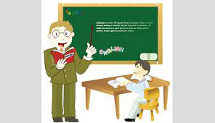


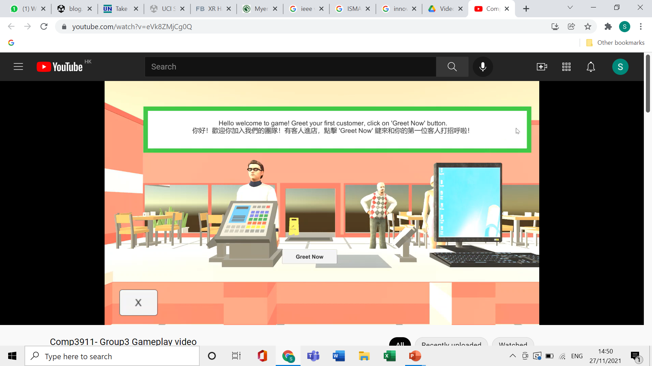
Background
Traditional teaching: Unsuitable for SEN students
Our game: Innovative methods to teach life skills
Notes:
Sweta

Slide 4



Service recipients
Target: SEN students
Traditional teaching unsuitable
Needs:
Education to suit their pace
Support and empathy in learning methods
Notes:
Emiri

Slide 5
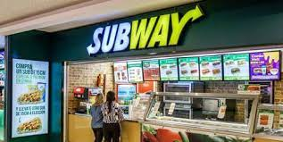
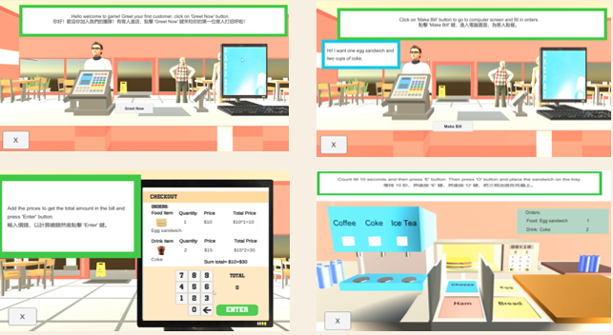
Objectives
Vocational Training
Help students to understand the workflow of a sandwich shop.
Reference taken from Subway
Greet to the customers (NPC), Charge Calculating and Food and Drink make
NPC Character
Greet customer
Billing
Make food and drinks
Notes:
Hung

Slide 6
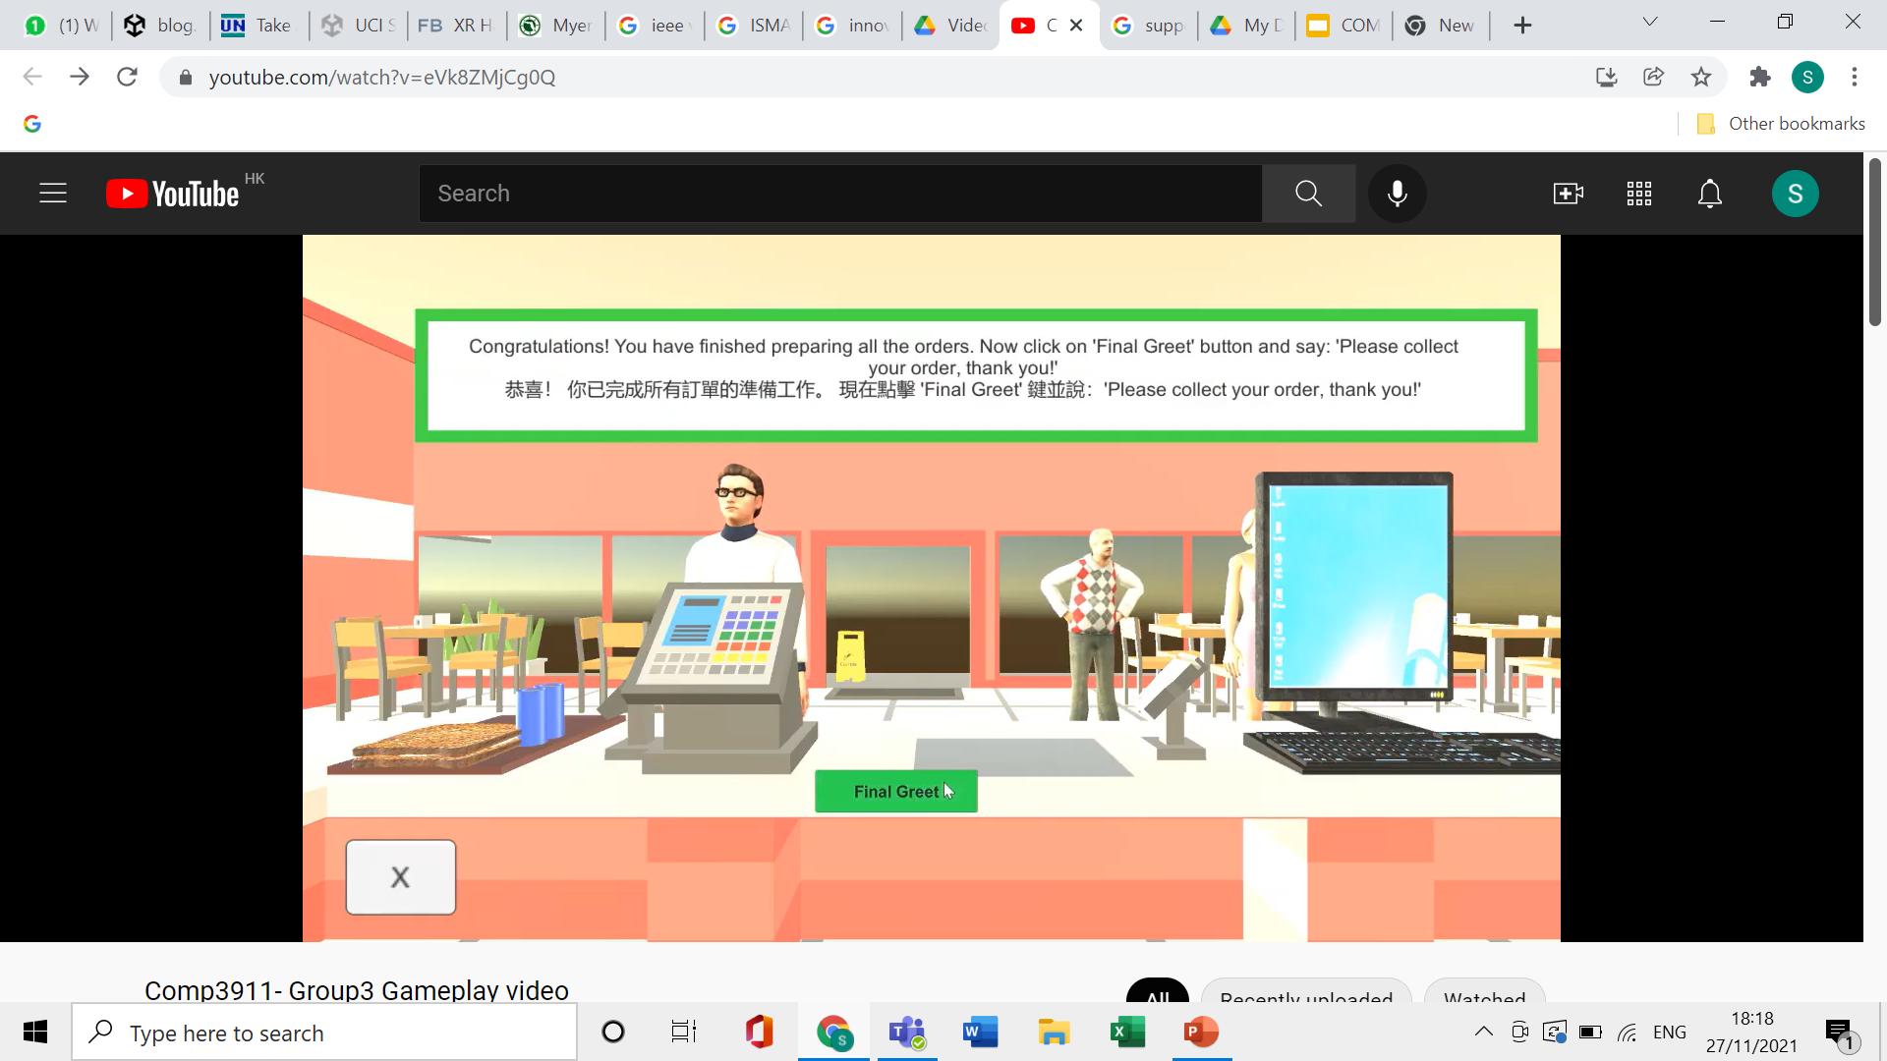
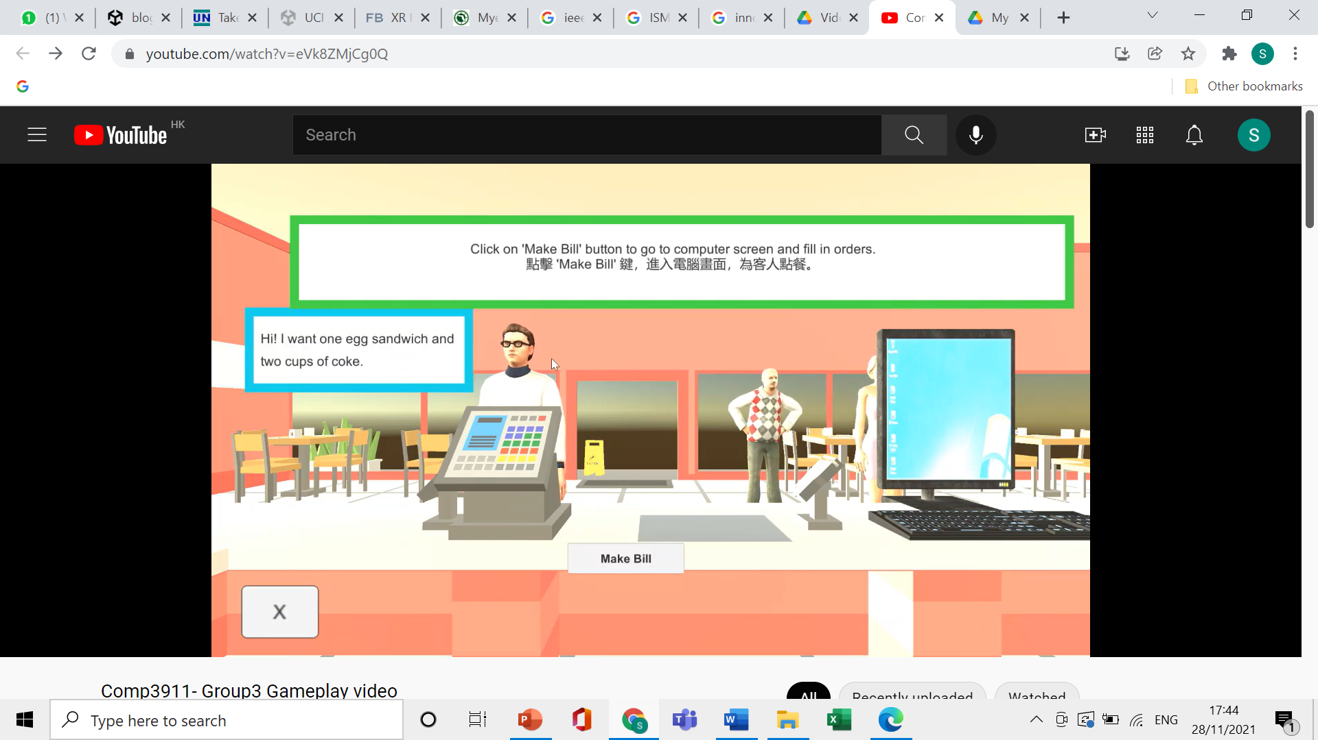
Objectives
Speaking to customers
Receiving response of orders
Social
Improve student’s communication ability by listening and responding in a conversation
Speak out their choices for activities
Greet to the customers (NPC) by speaking
Help the customers (NPC) to make orders
Express their feelings about the game
Notes:
Hung

Slide 7
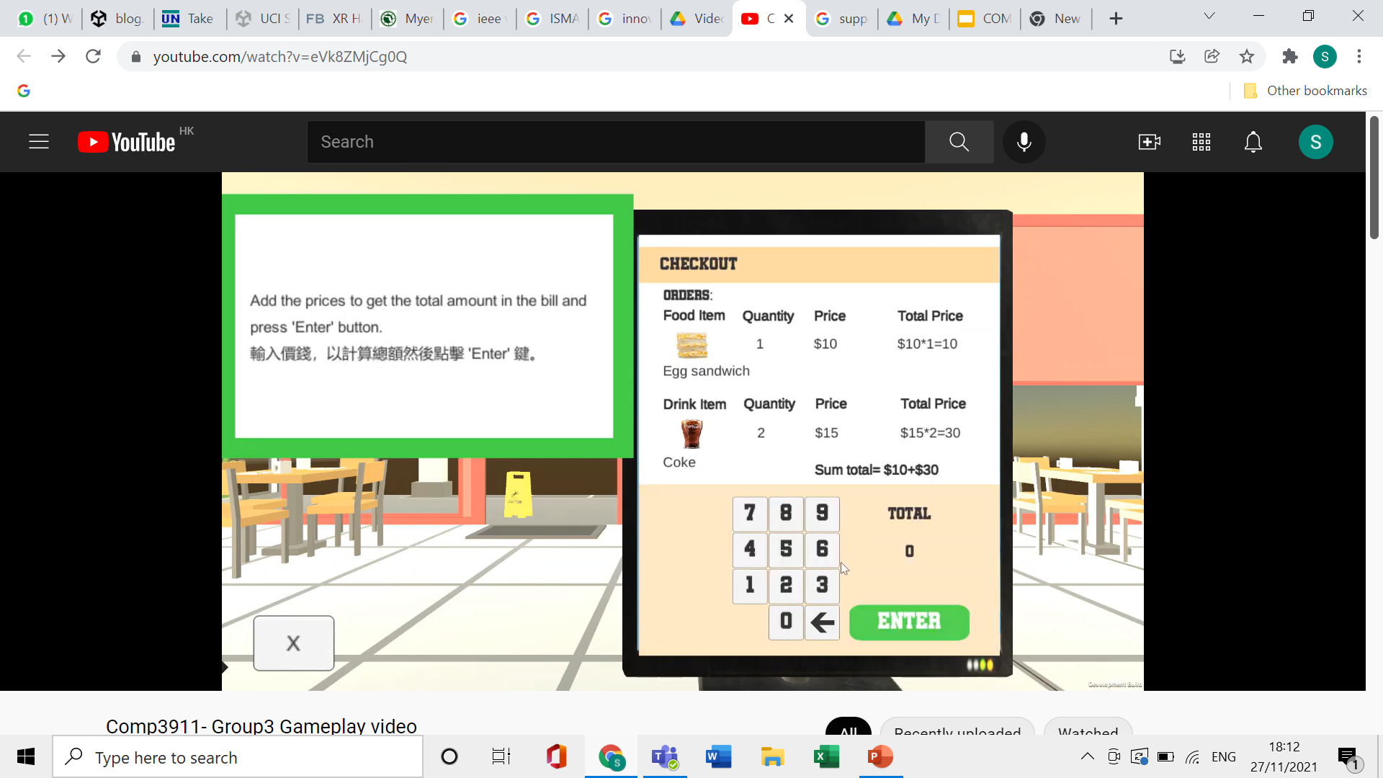
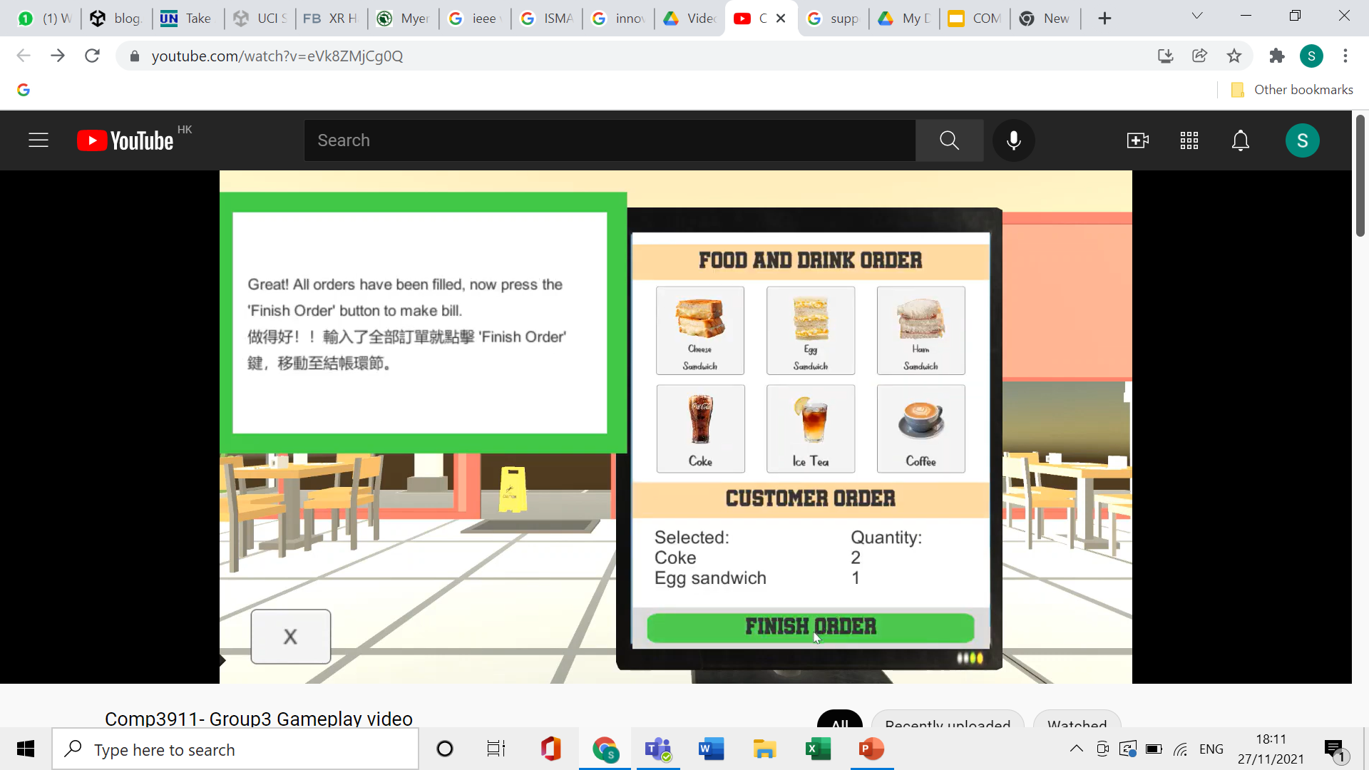
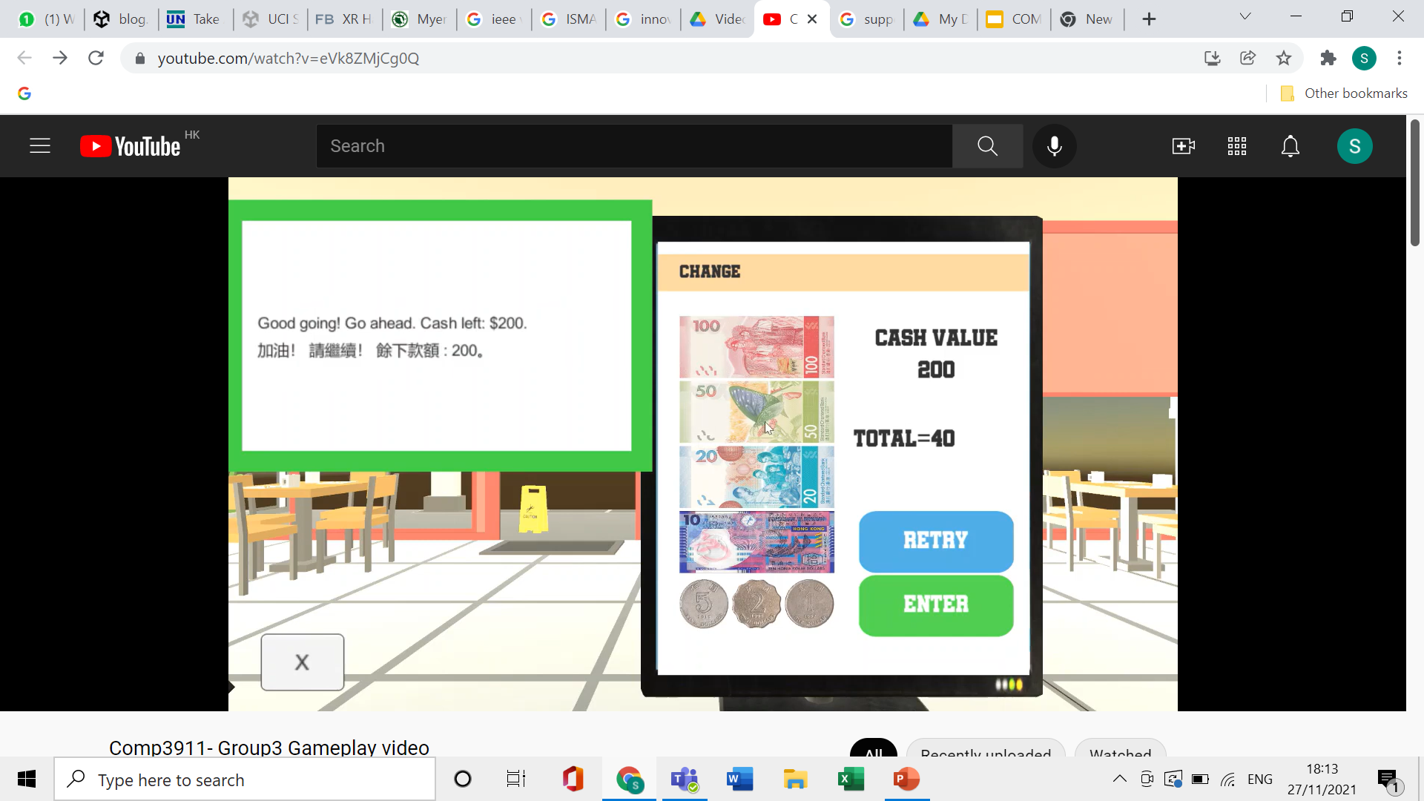
Objectives
Education
Improve student’s calculation ability
Bill Calculating
Distinguish Banknote
English vocabulary
Food: Ham/Egg/Cheese/Bread
Drink: Coffee/Coke/Ice Tea
Career Development
Allow students to experience the sandwich shop stuff and take a reference in career development
Calculation in Bill
Distinguish notes
Vocabulary of words
Notes:
Hung

Slide 8




Game
Training simulation game
Restaurant simulation game which helps the students to learn a life like simulation
The player has the role of the cashier and cook
The functions are designed to give a sense to the students about the working in restaurant
Notes:
Sweta

Slide 9
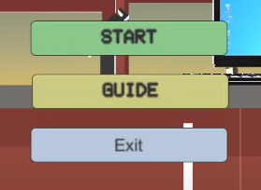
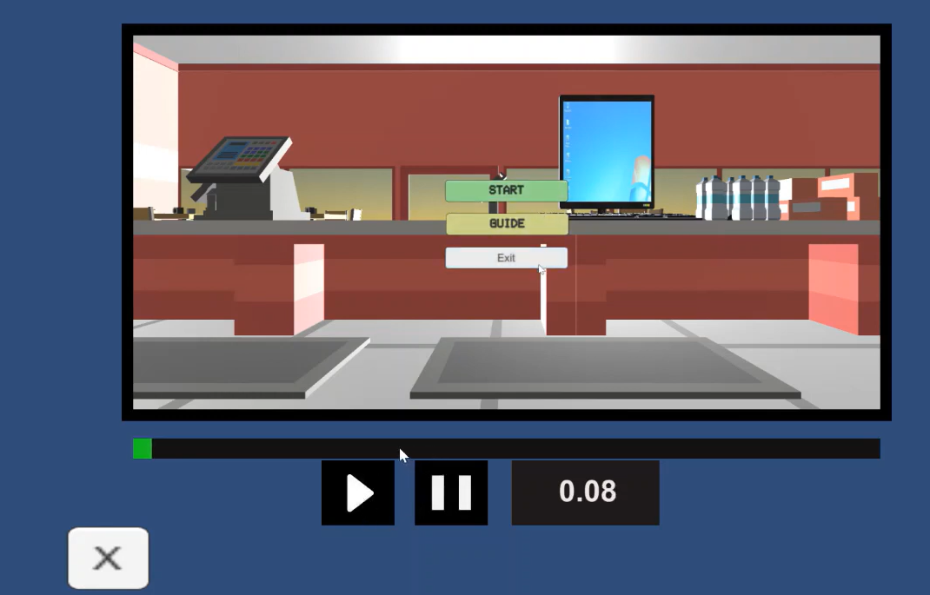
Game
Main Page
Guide
Notes:
Sweta

Slide 10

Game
Greeting customer: Knows how to do conversation and take order of customer.
Notes:
Sweta

Slide 11
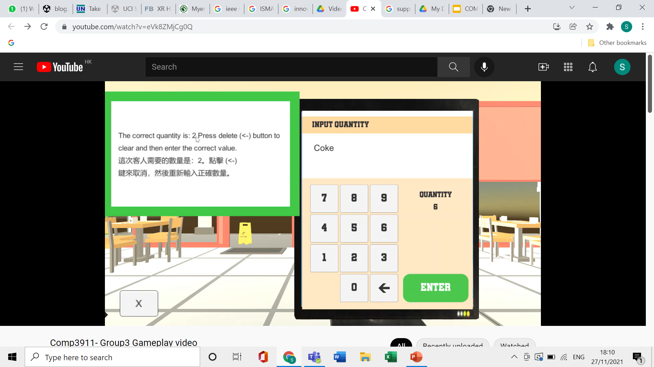
Game
Making bill on computer: Knows how to add items to the bill to test memory. Also learn basic calculation.
Taking cash and returning change: Helps in calculation and sense of responsibility to return cash.
Notes:
Sweta

Slide 12
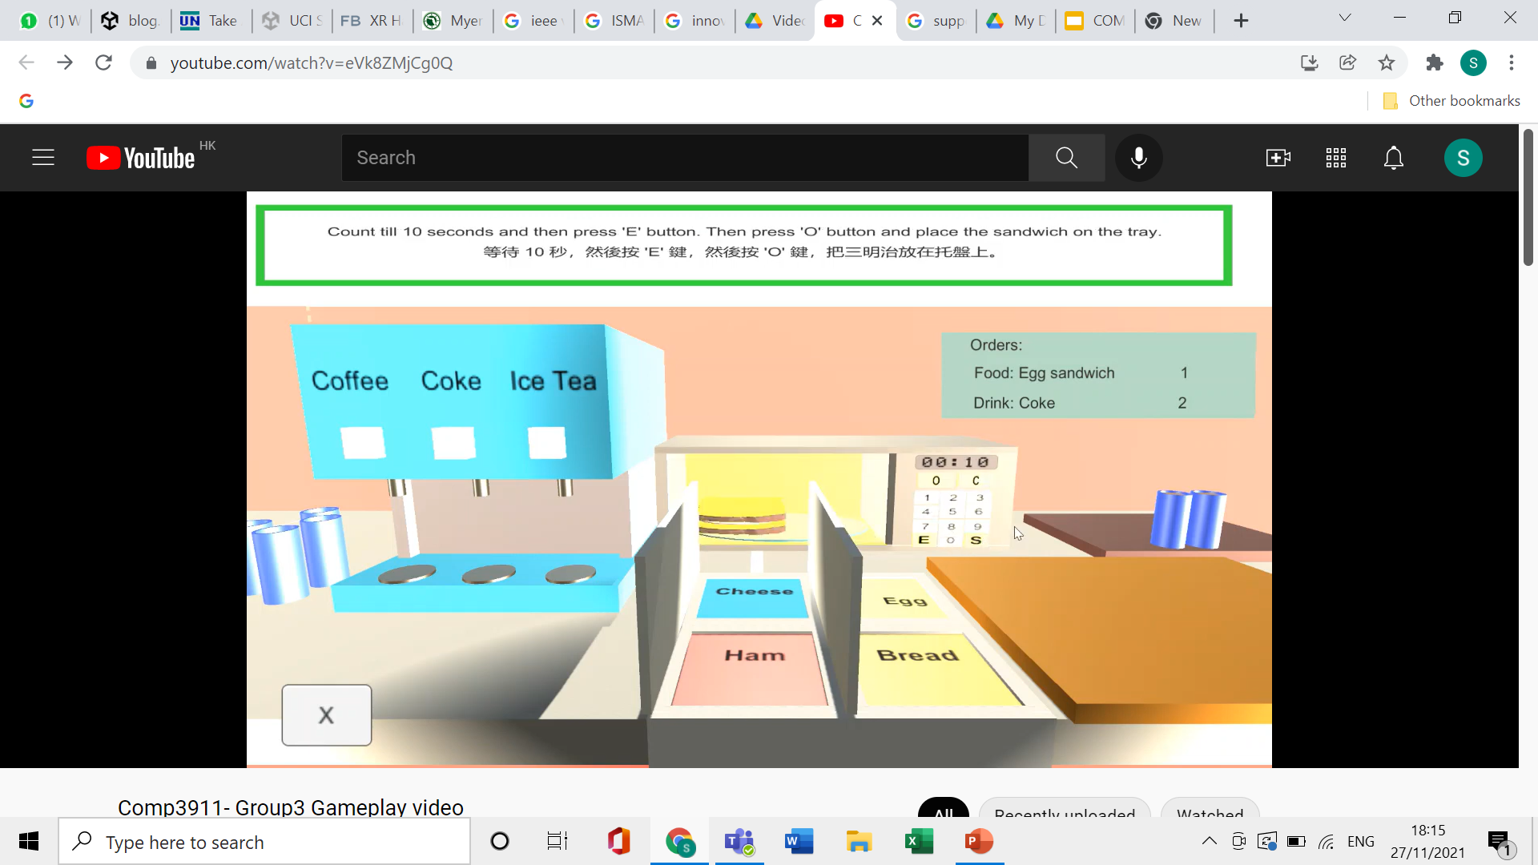

Game
Making drink: Knows how to use a coffee machine and pour the correct drink, only the amount that is needed.
Making food: Knows how long to cook the food, use correct ingredients responsibly, use microwave oven.
Notes:
Sweta

Slide 13

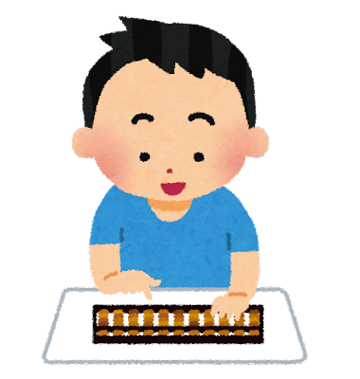
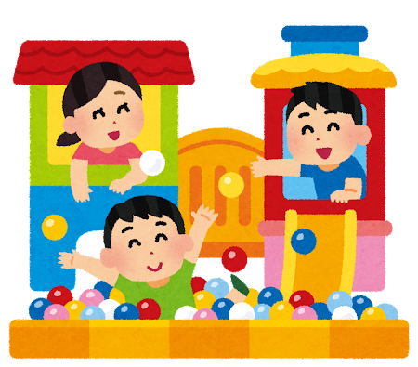
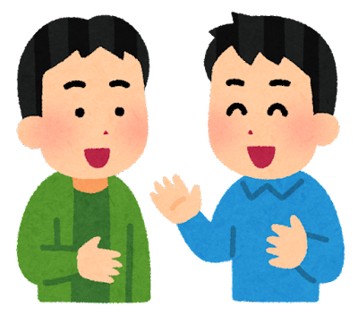

Expected Outcomes
Improve calculation skills
Learn the name of foods
Learn about cooking
Learn the types of money
Be proactive in greetings
Enjoy above all else
Notes:
Emiri

Slide 14
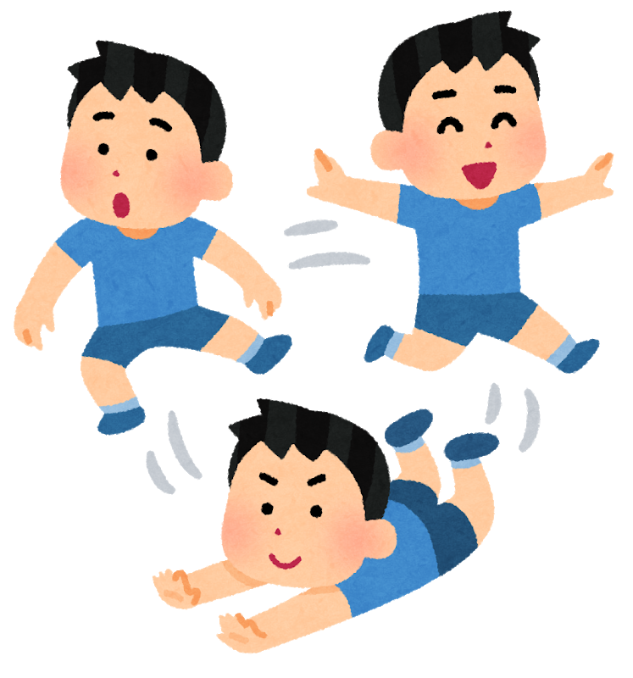
Observations
1. Level of Attentiveness
Concentrate on things they found interesting
Mostly interested in storytelling and playing video game
2. Interaction
mostly unable to speak and therefore hard to communicate
some like look around, shaking head, moving body
3. Skills
Computer skills
Can Control mouse
Can control mouse to draw
Calculate mathematics skills
Only can handle some simple math questions
Sometimes does not recognize numbers
Notes:
Tuning

Slide 15
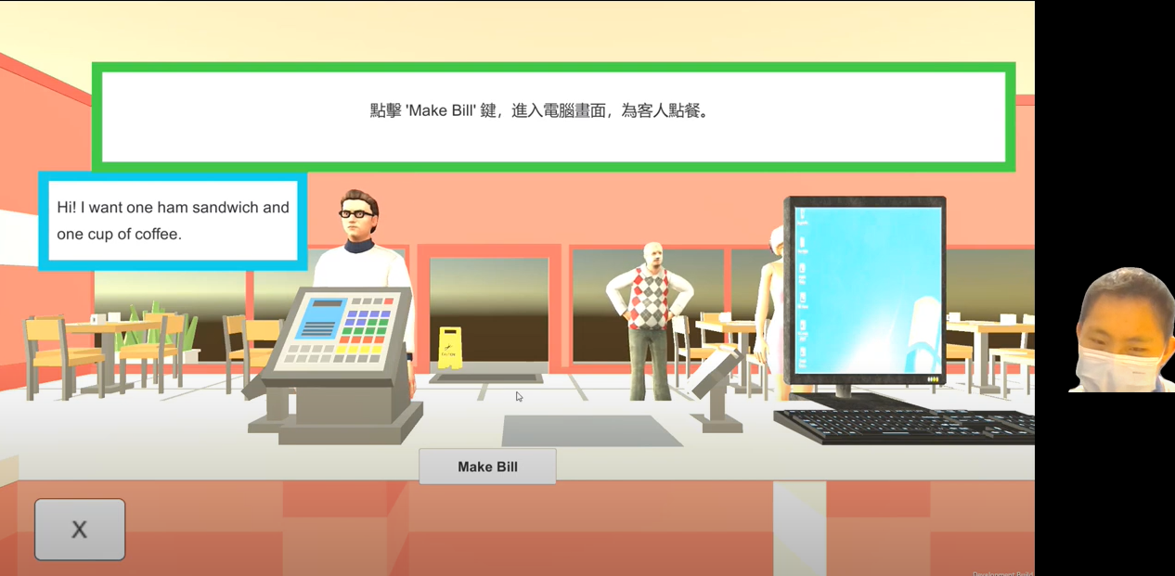
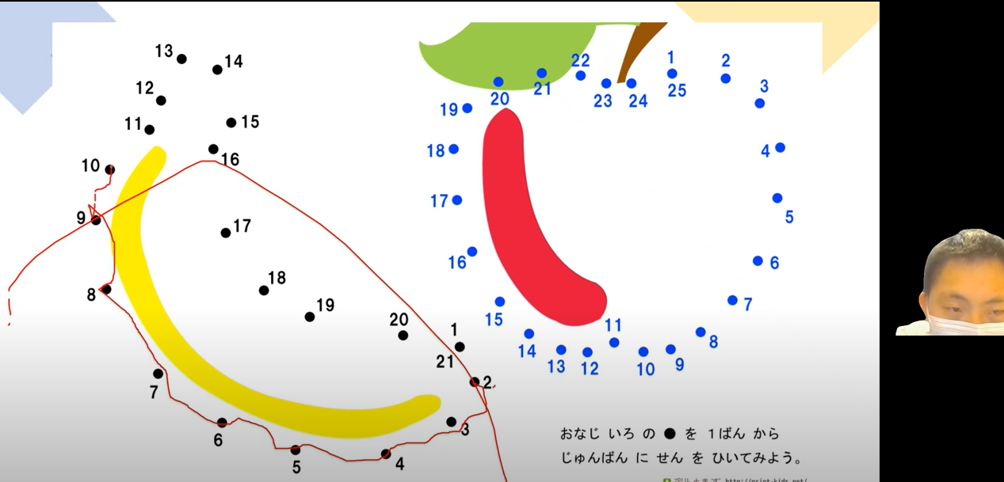
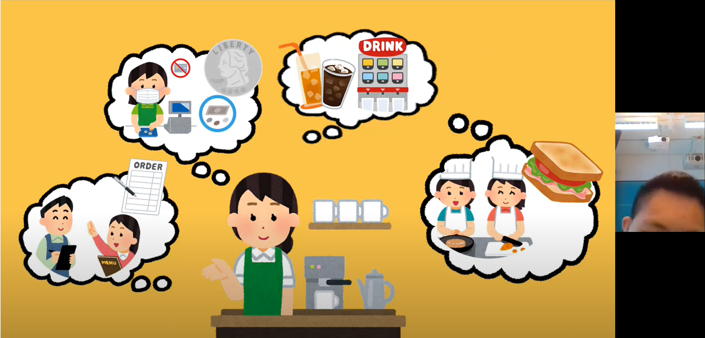
Observations
Individual case. Yip - Service Flow
Ice-breaking
Game
Ask questions
Notes:
Emiri

Slide 16
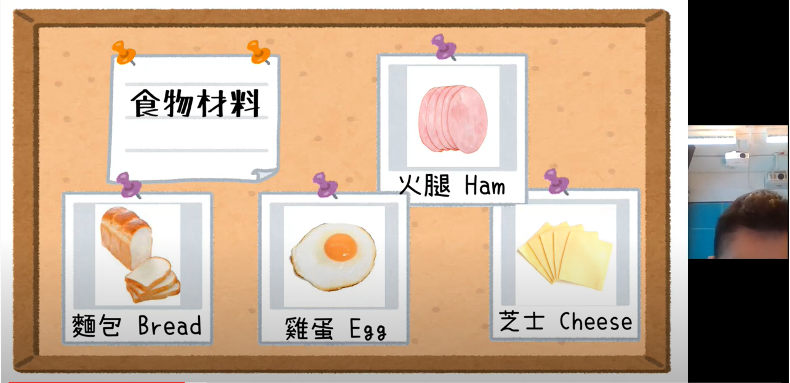
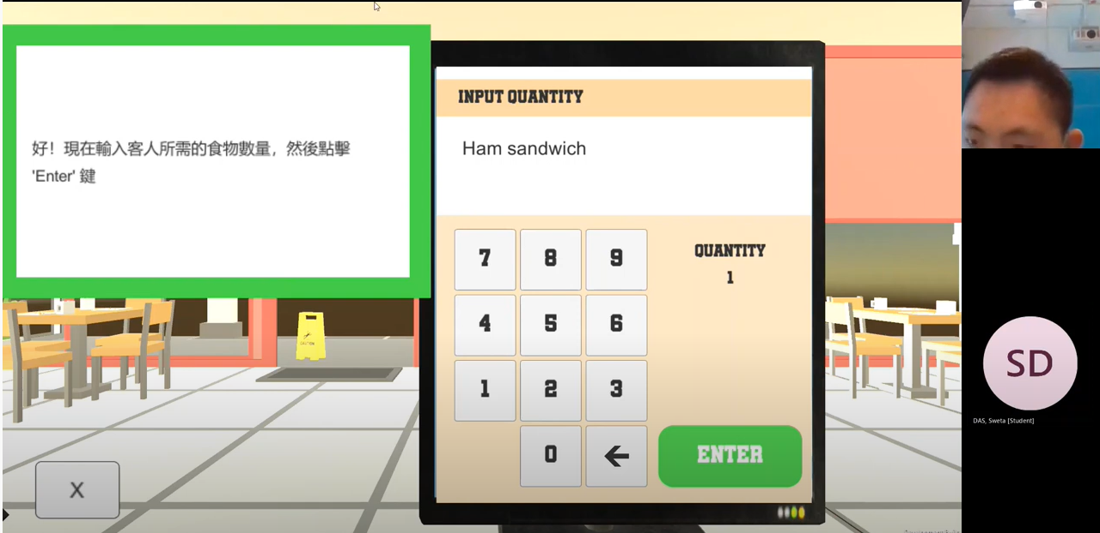
Observations
Individual case. Yip - First Service
Greet NPCs on own
Did not understand the English names of foods like ham
Take arounds ~15 secs to calculate 3+1
Service on 7th OCT
https://www.youtube.com/watch?v=V00p2KSn_9g
Notes:
Emiri

Slide 17
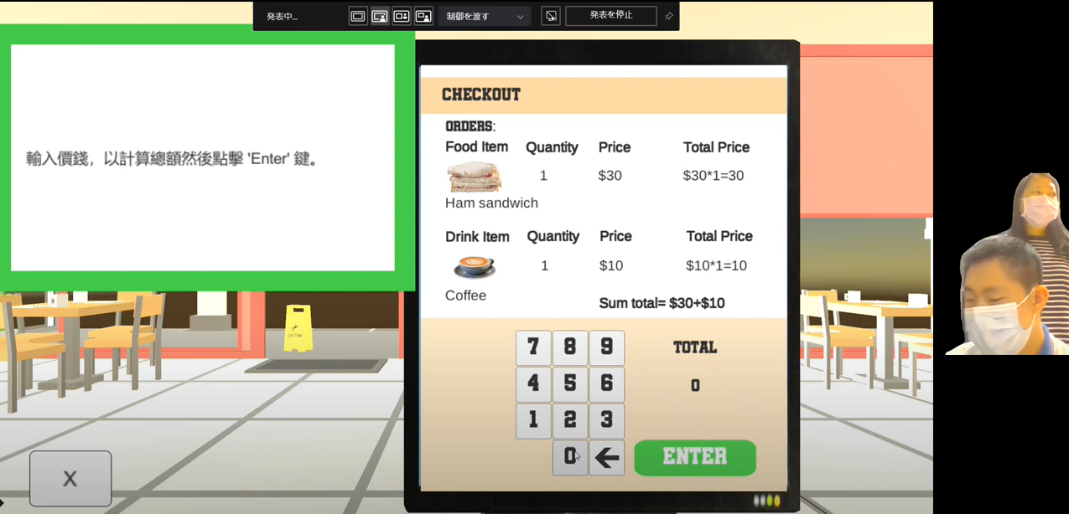
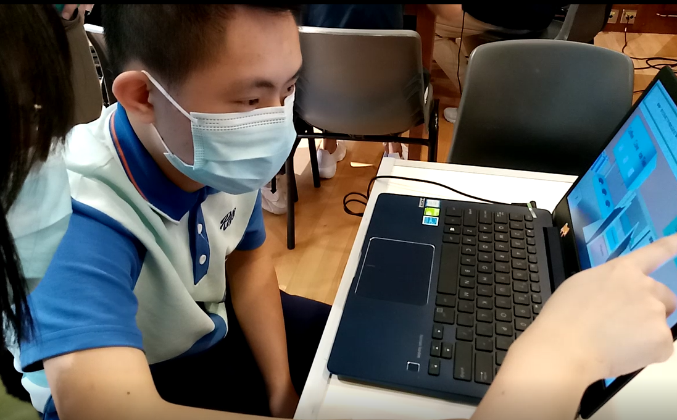
Observations
Individual case. Yip - Second Service
Greet NPCs on own
Understand which drink Coffee meant and which food Ham meant
Take arounds ~10 secs to calculate 3+1
Service on 21st OCT
https://www.youtube.com/watch?v=-MCK664WGI4
Notes:
Emiri

Slide 18
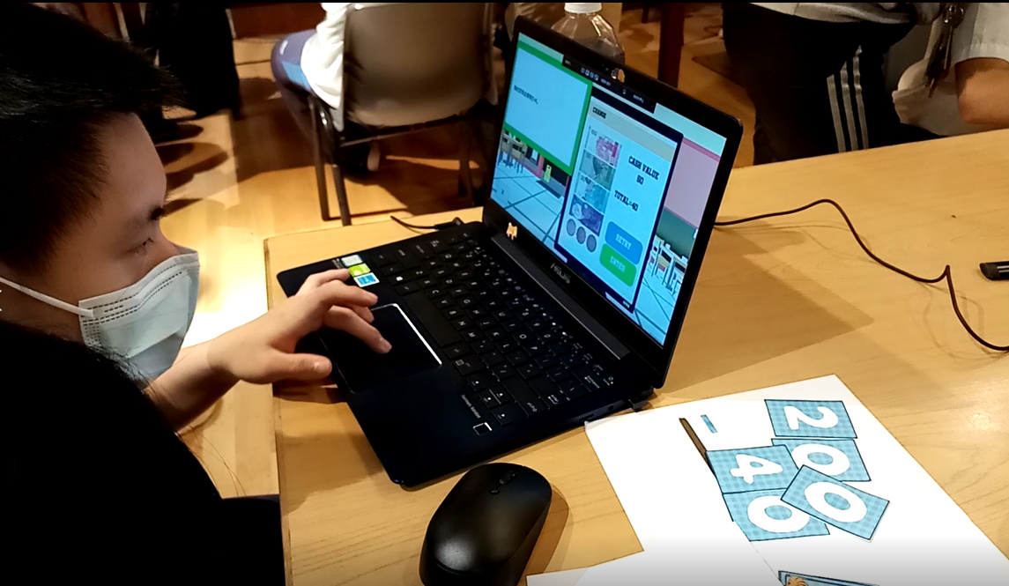
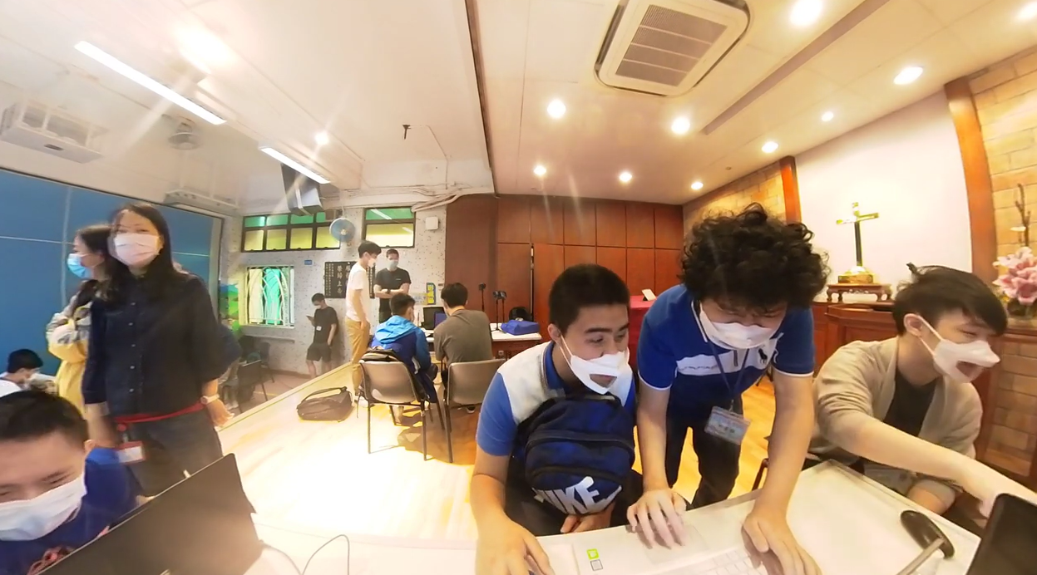
Observations
Individual case. Yip - Third Service
Greet NPCs on own
Greeted me himself
Understand the drinks and food in English
Take arounds ~9 secs to calculate one digit
Service on 28th OCT
https://www.youtube.com/watch?v=Ue2DRY4Z8cw
Notes:
Emiri

Slide 19
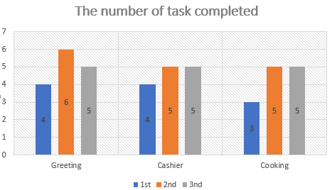
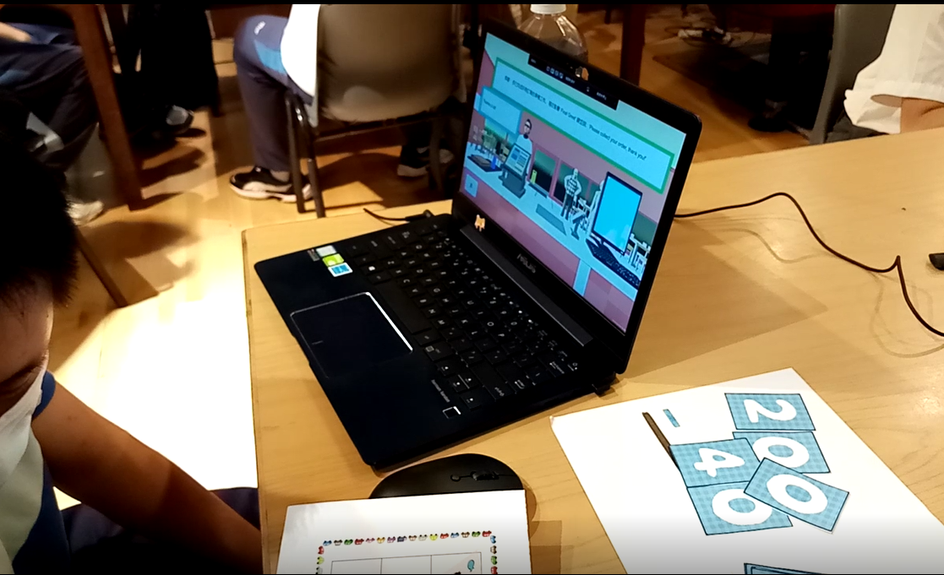
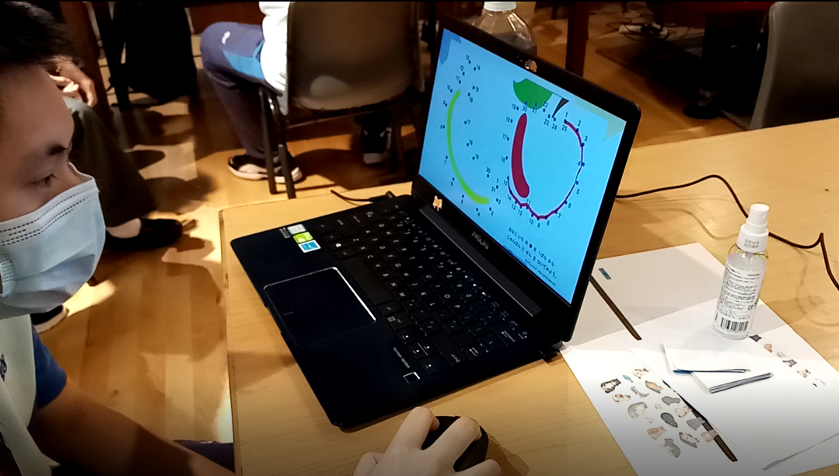
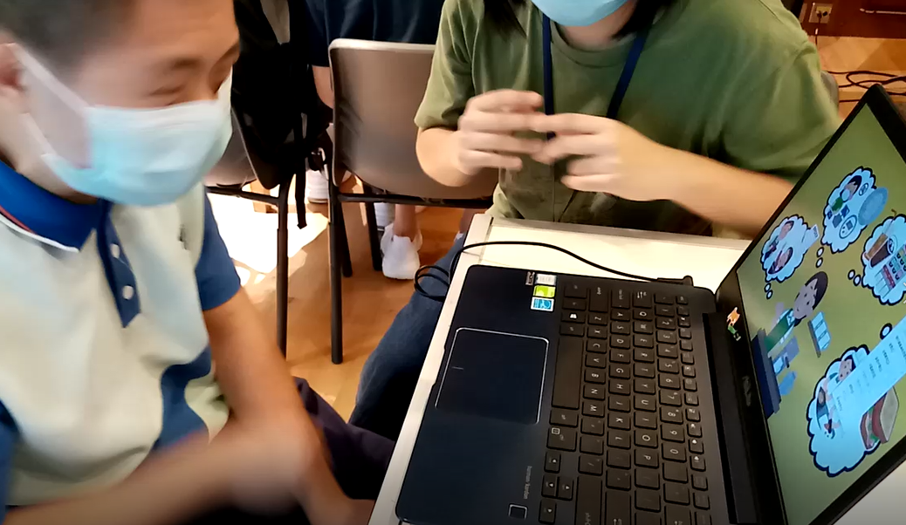
Observations
Individual case. Yip
The length of the service was different for each day, but the time to complete the task became faster with each session, and the number of completed task have been increased
Didn't show any interest in the Ice Breaking game
Enjoyed to read the guidebook in picture book form
After the third service, he started playing the game on his own
Notes:
Emiri

Slide 20
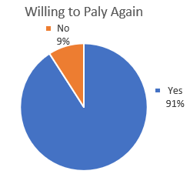
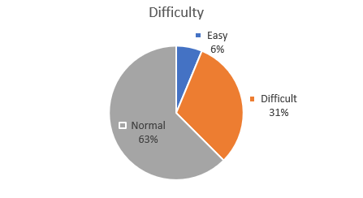
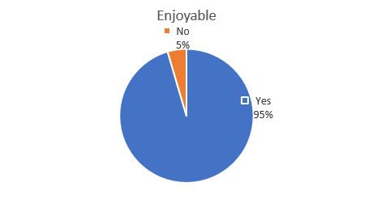
Observations
Questionnaire for students
Most of the student :
Willing to play the game again
Enjoy to play the game
Appropriate game difficulty
Notes:
Emiri

Slide 21

Overall
Improved the calculation speed
More Interactive
Learned the name of the foods
Learned how to make sandwiches
Learned the type of money
Enjoy the game
Notes:
Tuning

Slide 22



Outcomes
1. Increased cognitive ability of the children
At first struggle to do the task
After a few tries able to do it without guidance
2. Improved children’s abilities
Operating a computer
Mathematical proficiency
Social and speaking ability
3. Knowledge
Children is able to recognize types of food
Know the differences of money currencies
Notes:
Tuning

Slide 23



Major Improvements
Ice-Breaking
Different Devices
Incentive
Since many of the students were not interested in the ice-breaking game we had originally prepared
We have tailor made the ice breaking game for each student.
There were some students who didn't understand how to use a computer,
so we prepared a tablet for those student.
To motivate the students, we gave them stickers as a reward for completing the task.
As a result, the students became more proactive.
Notes:
Emiri

Slide 24

Major Improvements
Separate Language version
To be clearer with students having Cantonese as their mother tongue, we made a separate Cantonese only version of the game.
Notes:
Emiri

Slide 25


Future Improvements
“Menu” Function
Mobile or PC Choice
More voice interaction
Able to pick specific levels within the game
Allow student to train specific sections
Limited tablet for our team, acquire more tablet
Allow the student to choose to use touchpad or mouse
More encouragement for students to speak
Add more interactions, e.g ask for the student’s name
Notes:
Aristo

Slide 26



Reflection
Adaptability and Flexible
Be Proactive and Positive
Gratitude
Many unexpected bugs/problems in real life implementation
Stay calm, adapt to situations, and fix the problems
Better to be open minded and flexible to your project
If you have a problem, don’t ignore it, fix it yourself or ask someone to help
Stay positive at bad situations, always thinking negative wont fix anything
Be thankful of what you have
Help others with the ability that you have
Notes:
Aristo

Slide 27
Comments by Each member
“Appreciation to the teachers and students who went through this experience together. Hope for the best for them. “
- Gunawan Aristo Sinatra
“We hope the SEN students can take the experience as a reference when they need to design their career path. “
- Wu Chun Hung
“With this service, found that games are an effective tool for education. I hope that the game we created this time can help them in their vocational training. “
- Leung Emiri
“We aimed to make a simple game to teach real life skills to SEN students and make them competent enough to have a part time job at restaurants like other normal students. “
- Sweta Das
“The experience of teaching SEN students through game is special and meaningful. Different from original teaching, game is more interesting for them to learn. It is new try for them to use different tools in learning and get experience of vocational training.“
- Tun Ning Wan
Notes:
All

Slide 28

Thank you

